Slide 1
Week 4 Live Session
Wendy Christensen, Ph.D.
COMP 4442
Spring 2021

Slide 2
Agenda
Course logistics
Problem Set 3 questions
Boxcox question review
Evaluating the regression model as a whole
Comparing models
Nested model testing
Information criteria
Automated model selection
Problem Set 4 overview

Slide 3
Upcoming deadlines (all 11:59 p.m. MDT)
Week 3 Participation: Due Sunday, 4/18 (past due, please get these in)
Problem Set 3: Due this Friday, 4/23
Week 4 Participation: Due this Sunday, 4/25
Assigned today: Problem Set 4, due 4/30 (next Friday)

Slide 4
Course Logistics
Next week is Week 5. Per the syllabus, two things will happen next week:
Midterm exam will be distributed and due the following Friday
You will begin signing up for final project topics. Before the beginning of next week’s live session, please have done the following:
Think of three (or more, but at least three) methods that you would be potentially interested in exploring for the final project
Post your choices as replies to the post in the Final Presentation Topic Sign-Up message board.

Slide 5
Problem Set 3 questions?

Slide 6
Box Cox transformations
One approach to handling data that do not meet the assumption of normality is to transform variables in the analysis.
Linear transformations of a variable (e.g., multiplying by a constant) shift the location of the distributions but don’t change the shape of the variable’s distribution.
Nonlinear transformations (e.g., taking exponents and logs) do change the location and shape of the variable’s distribution. The Box Cox transformation is an example of a nonlinear transformation.

Slide 7
Box Cox transformations
The goal of a Box-Cox transformation is to identify an exponent - denoted as lambda (ƛ) - that will transform the outcome variable such that the residuals of the model to be as normally distributed as possible.
The boxcox() function (part of the MASS library) does this by comparing model log-likelihoods for different values of lambda. By default, the range of tested lambdas is -2 to 2 and the step size is 0.1. Thus, 100 models - containing the same predictors and differents transformations of the outcome - are re-fitted and the transformed-outcome model with the highest log-likelihood is considered the best.

Slide 8
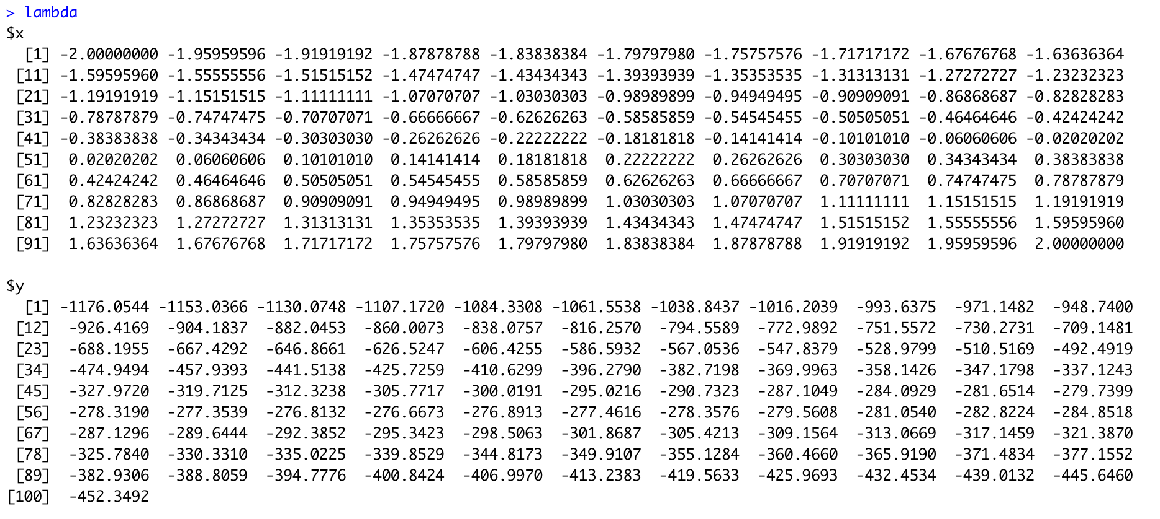
Box Cox transformations
Lambas for 100 models
Log-likelihoods for 100 models
The output of the boxcox() function is a range of lambdas and the log-likelihoods of the model associated with each lambda. You don’t have to look at them individually, but you can if you so choose.

Slide 9
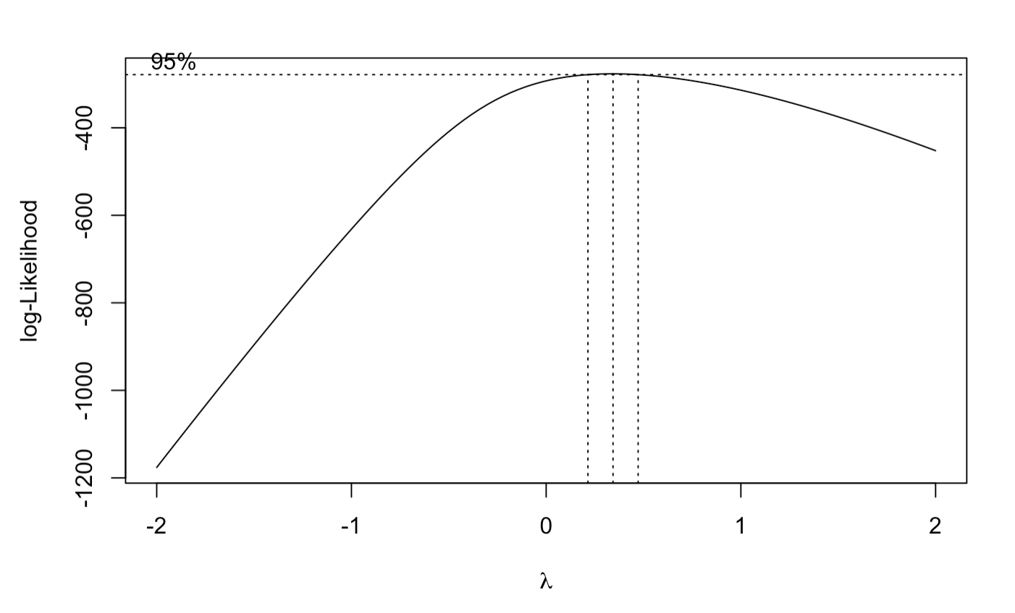
Box Cox transformations
By default, the boxcox() function displays these lambdas and log-likelihoods graphically.
Per the graph, the best value of lambda is somewhere between 0 and 1. It’s closer to 0 than one, so you can tell by looking that the best lambda is less than 0.5

Slide 10
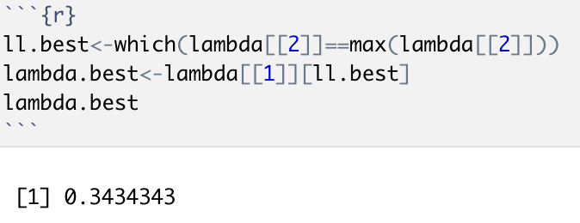
Box Cox transformations
Using the max() function, we can see that the lambda that maximizes the model’s log-likelihood is 0.3434343. This value is saved as an object called “lambda.best” so you can use it for the next step.

Slide 11

Box Cox transformations
The last step of a Box Cox transformation is re-conducting your regression analysis using the same predictor variables as before to predict the transformed outcome variable. That is, only the outcome variable changes.
New Y =
The y in the equation is the untransformed outcome variable. The lambda in this case is 0.3434343. If the old outcome value was 4.48 (the outcome of the first observation in the data set), what would the new value be?
You will have as many new outcome values as old outcome values.

Slide 12
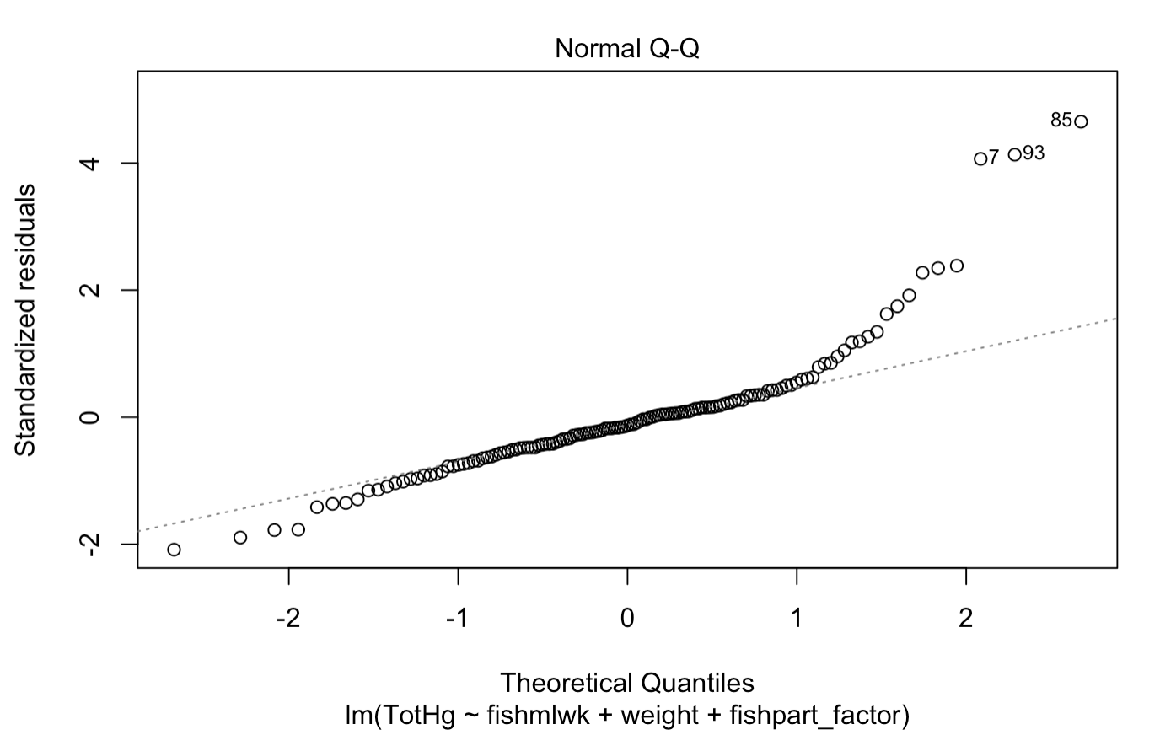
Box Cox transformations
Old QQ plot:
New QQ plot: ?
Because the goal is to make the model residual distribution more normal, it makes sense to compare the QQ plot of the untransformed model to the QQ plot of the transformed model.
Do you think that this procedure is guaranteed to be successful (i.e., produce an ideal QQ plot for the model using the transformed outcome)?

Slide 13
Aside: Model diagnostics as iterative process
While model and case diagnostics (assumption checking and identification of potentially influential points) is often presented as a “once-and-done” step in analysis, it tends to be an iterative process in practice. My tips for this process:
Make one change at a time. This includes dropping cases.
Re-examine all of the diagnostic plots after each change
My opinion: If you decide that you need to make some changes based on your diagnostic plots, it’s best to first consider your potentially influential points. This is because influential cases often contribute to poor model diagnostics, so you can sometimes fix problems just by dropping an influential point or two.

Slide 14
Evaluating the regression model as a whole

Slide 15
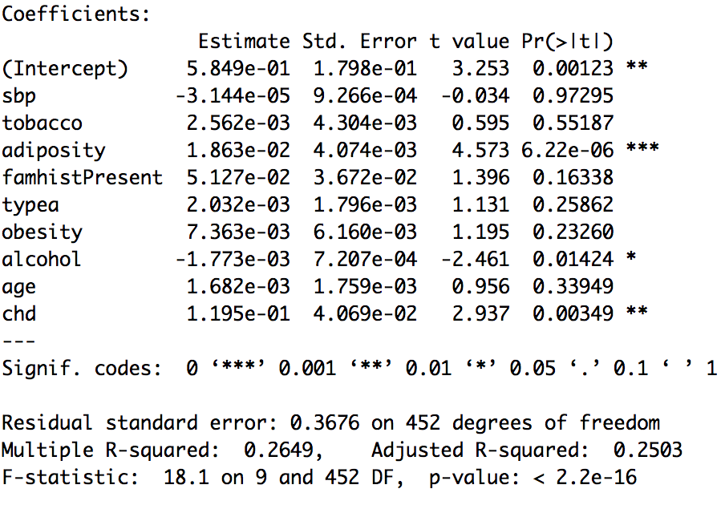
Multiple regression - output
As a reminder, this output is from the async material. The outcome was the log of the participant’s LDL cholesterol, and there were both categorical (e.g., chd, a diagnosis of coronary heart disease) and numeric (e.g., age, the participant’s age in years) predictors used.
Last week, we looked at how we can evaluate the individual predictors by looking at their coefficients.

Slide 16
Multiple regression - residual stnd error
We also have information about the model as a whole (or, stated differently, the predictors as a set).
The first of these is the residual standard error for the whole model. This is akin to the MSE you saw in ANOVA.

Slide 17
Multiple regression - R-squared
Next is multiple R-squared. This is interpreted as the proportion (or, if multiplied by 100%, the percent) of variation in the outcome accounted for by your model.
Thus, this model accounts for about 26% (0.2649) of the variability in participants’ LDL cholesterol (log LDL). It would change if I added or removed predictors from this model. It would also change if I fit this same model to a different data set.

Slide 18
Multiple regression - adjusted R-squared
Next is adjusted R-squared, which is similar to multiple R-squared. The key difference is that the adjusted R-squared of a model can potentially go down if a “useless” predictor is added to a model. Regular R-squared won’t ever decrease as predictors are added, so a genuinely “useless” predictor will cause no change at all in R-squared.
If the adjusted R-squared value is much lower than the multiple R-squared value, that suggests that there are predictors that aren’t contributing much to accounting for variability in the outcome.

Slide 19
Multiple regression - omnibus F test
Last is an F-test of the model as a whole, which is why this particular F-test is sometimes referred to as an “omnibus F-test”. Note that the numerator df is the number of predictor coefficients in the model.
This is an important test, and it’s very important to know precisely what is being tested here.

Slide 20
Multiple regression - omnibus F test
One version of the null and alternative hypotheses for the omnibus F test is as follows:
Null: All coefficients in this model are equal to zero in the population
Alternative: At least one coefficient in this model is different than zero in the population.

Slide 21
Multiple regression - omnibus F test
There is another version of these, though:
Null: The inclusion of this set of predictors does not account for significantly more variability in the outcome than a mean-only (also called a “null” or “intercept-only”) model.
Alternative: The inclusion of this set of predictors accounts for significantly more variability in the outcome than a mean-only/null/intercept-only model
That is, the omnibus F test is actually a sneaky example of model comparison. Interesting, huh?

Slide 22
Comparing models

Slide 23
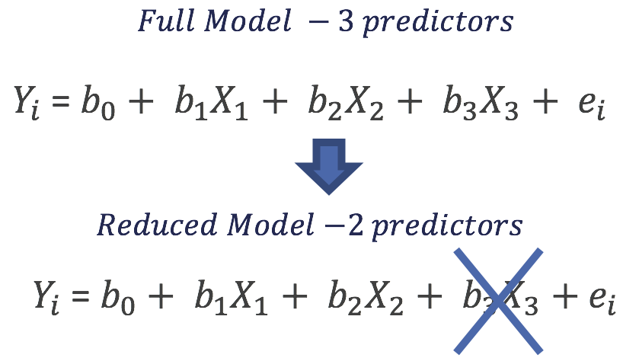
Nested model comparison
Two models are considered nested if the smaller model can be specified by setting parameters of the larger model to zero.
The example on this right shows a pair of models that are nested. This is because the reduced model can be specified by setting the b3 parameter in the full model equal to zero.

Slide 24
Nested model comparison
Null: The full model does not account for significantly more variability in the outcome than the reduced model
Alternative: The full model accounts for significantly more variability in the outcome than the reduced model.
Note: You can test several nested models in a sequence, but you’re only testing two models at any given time.

Slide 25
Nested models - the F-change test
To do nested model tests in R, you can use the anova() function. It will conduct an F-test (specifically, an F-change test) by default, which is what you need to compare nested regression models.
Note that order matters when entering your models into the anova() function! If you enter the models backward, you will get a correct F test statistic and p-value, but your degrees of freedom will be negative. Make sure the DF are always positive.

Slide 26
Information criteria
Information criteria are more flexible than nested model testing methods.
Models do not have to be nested; rather, they only need to share an outcome variable and be fitted to the same set of observations.
You can compare as many models as you want simultaneously.
As the term may suggest, the logic of information criteria is based in information theory. Because these weren’t developed using the statistical null hypothesis testing framework, there aren’t any p-values. Rather, the “best” model is the one with the lowest value for a given criterion.

Slide 27


The most common information criteria
AIC (Akaike information criterion, named for the person who propose it) formula:
BIC (Bayes information criteria) formula:
Note that BIC is sometimes referred to as the Schwarz-Bayesian information criteria (SBC), which incorporates the name of the person who proposed it.

Slide 28
Information criteria - similarities
AIC formula:
BIC formula:
Number of parameters

Slide 29
Information criteria - similarities
AIC formula:
BIC formula:
Deviance is a transformation of the model likelihood (-2 * log(likelihood))
“Deviance” (-2LL)

Slide 30
Information criteria - differences
AIC formula:
BIC formula:
Notice that AIC doesn’t incorporate sample size, but BIC does
Sample size

Slide 31
Information criteria - differences
AIC formula:
BIC formula:
Also notice that the first term in each formula is different. This is because they optimize for different aspects of model selection

Slide 32
Automated model selection exercise
In your groups, discuss the questions in the automated model selection exercise. Answering these questions will help you complete Problem Set 4, a large portion of which is conducting automated model selection.
We will review part of this exercise during class if time permits.

